Slide 1
19CSE211 Computer Architecture & Organization
Arithmetic for Computers – Part 1

Slide 2
Multiplication
Start with long-multiplication approach
multiplicand
1000
× 1001
1000
0000
0000
1000
1001000
multiplier
Partial products
product
Length of product is the sum of operand lengths

Slide 3
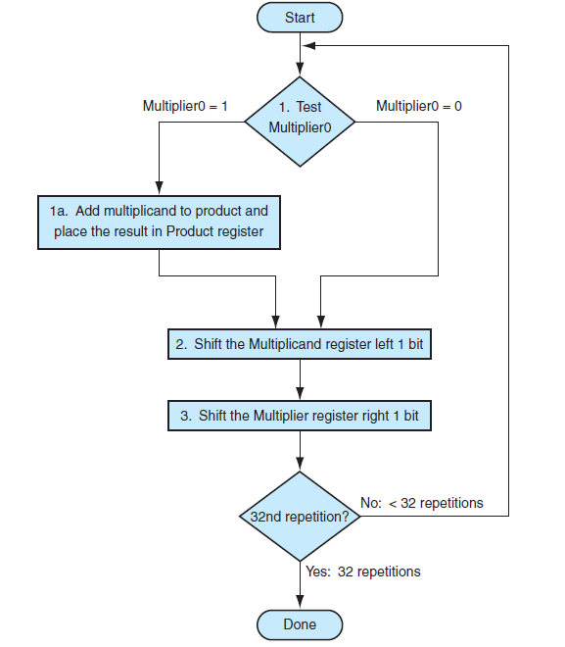

The first multiplication algorithm – Sequential Algorithm

Slide 4
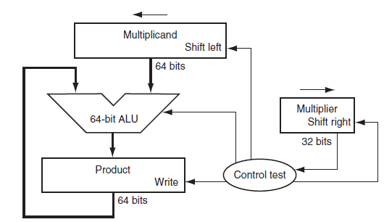
Multiplication hardware – Sequential Algorithm
Figure 3.5

Slide 5
EXAMPLE : A Multiply Algorithm
Using 4-bit numbers to save space, multiply 2_{ten} × 3_{ten}, or 0010_{two} × 0011_{two}. Figure 3.7 shows the value of each register for each of the steps labeled according to Figure 3.5, with the final value of 0000 0110_{two} or 6_{ten}. Color is used to indicate the register values that change on that step, and the bit circled is the one examined to determine the operation of the next step.

Slide 6
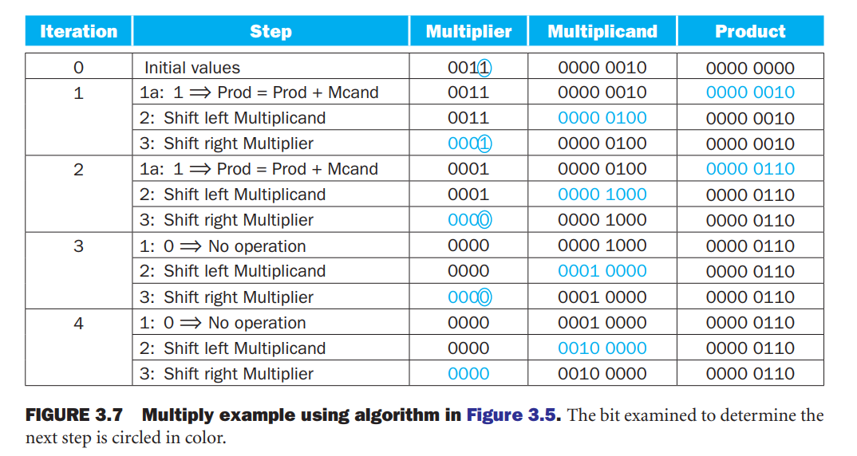
Multiply example

Slide 7
MULTIPLY HARDWARE
32-bit Multiplicand reg, 32 -bit ALU, 64-bit Product reg, (0-bit Multiplier reg)
Multiplicand
32 bits
32-bit ALU
Shift Right
Product
(Multiplier)
Control
64 bits
Write

Slide 8
Multiply Algorithm – Refined algorithm
Start
Product0 = 1
1.
Test
Product0 = 0
Product0
1a. Add multiplicand to the left half of product &
place the result in the left half of Product register
Product Multiplicand
2. Shift the Product register right 1 bit.
0000 0011 0010
1: 0010 0011 0010
2: 0001 0001 0010
1: 0011 0000 0010
2: 0001 1000 0010
1: 0001 1000 0010
2: 0000 1100 0010
1: 0000 1100 0010
2: 0000 0110 0010
0000 0110 0010
32nd
repetition?
No: < 32 repetitions
Yes: 32 repetitions
Done
Notes:
Mcand: 0010 P: 0000 0011
1a. 1=>P=P+Mcand Mcand: 0010 P: 0010 0011
2. Shr P Mcand: 0010 P: 0001 0001
1a. 1=>P=P+Mcand Mcand: 0010 P: 0011 0001
2. Shr P Mcand: 0010 P: 0001 1000
1. 0=>nop Mcand: 0010 P: 0001 1000
2. Shr P Mcand: 0010 P: 0000 1100
1. 0=>nop Mcand: 0010 P: 0000 1100
2. Shr P Mcand: 0010 P: 0000 0110

Slide 9
Multiply in MIPS
Product stored in two 32 bit registers called Hi and Low.
mult $s0,$s1
multu $s0,$s1
Results are moved from Hi/Low .
mfhi $t0 # $t0=Hi
mflo $t1 # $t1 = Low
Pseudo Instruction
mul $t0,$s0,$s1 # $t0 = $s0 * $s1

